Slide 1
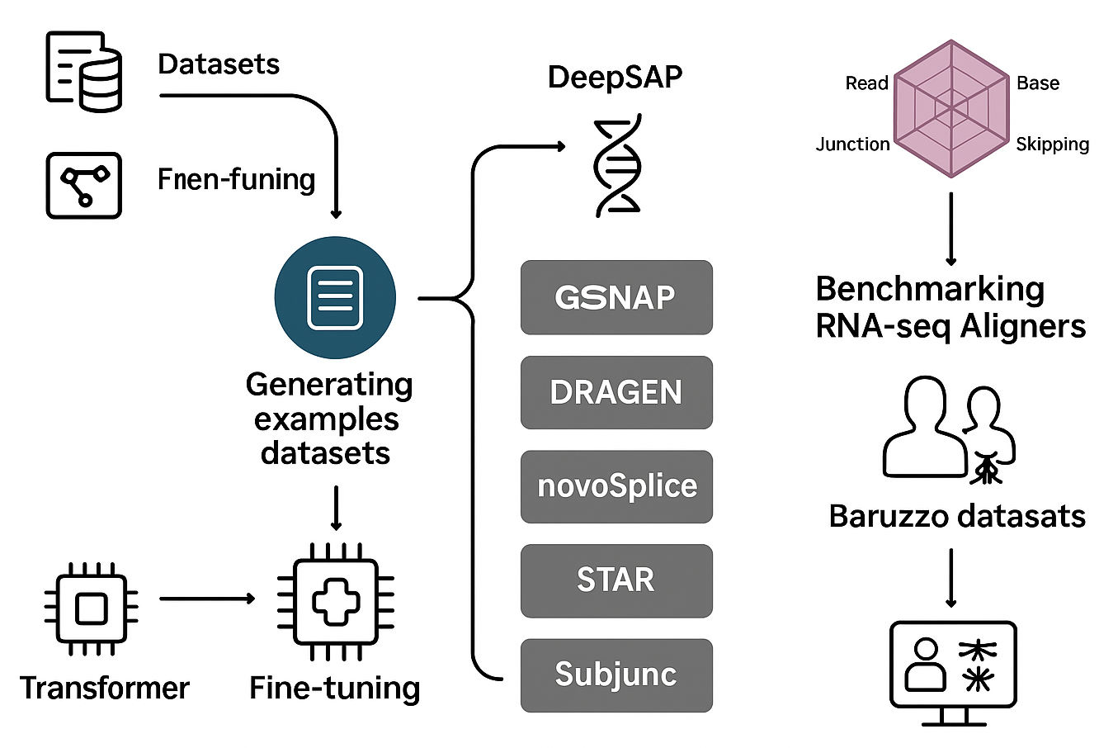
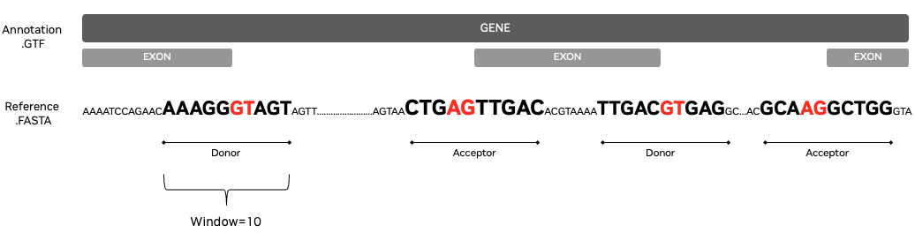
Fine-Tuning Transformer Models
DeepSAP
Benchmarking RNA-seq Aligners
Results
Multi Species References .FASTA
DeepSAP uses the GSNAP transcriptome-guided RNA-seq aligner to align RNA-seq short reads, followed by a post-alignment step that applies the DNABERT MS150 transformer to score donor and acceptor splice sites and adjust MAPQ values to enhance splice junction detection.
Benchmarking analysis using Baruzzo simulated datasets
Generating Examples Datasets
RNA-seq Aligners
Baruzzo Datasets
DeepSAP
Multi Species Annotations .GTF
Human T1
Human T2
Human T3
DRAGEN
Labeled datasets train, test & eval with window size 90, 150, 200 or 400
novoSplice
Malaria T1
Malaria T2
GSNAP TGGA Transcriptome Guided Genomic Aligner
Malaria T3
STAR
Baruzzo References
Fine-Tuning
DNABERT MS150
Fine-Tuned Transformer Model
HISAT2
GRCh37 Reference and Annotation
Pre-Trained Models DNABERT, DNABERT2, NT
Subjunc
Malaria Reference and Annotation

Slide 2
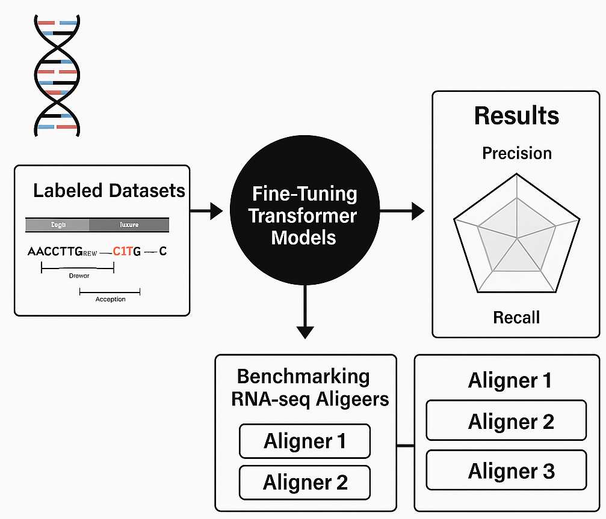
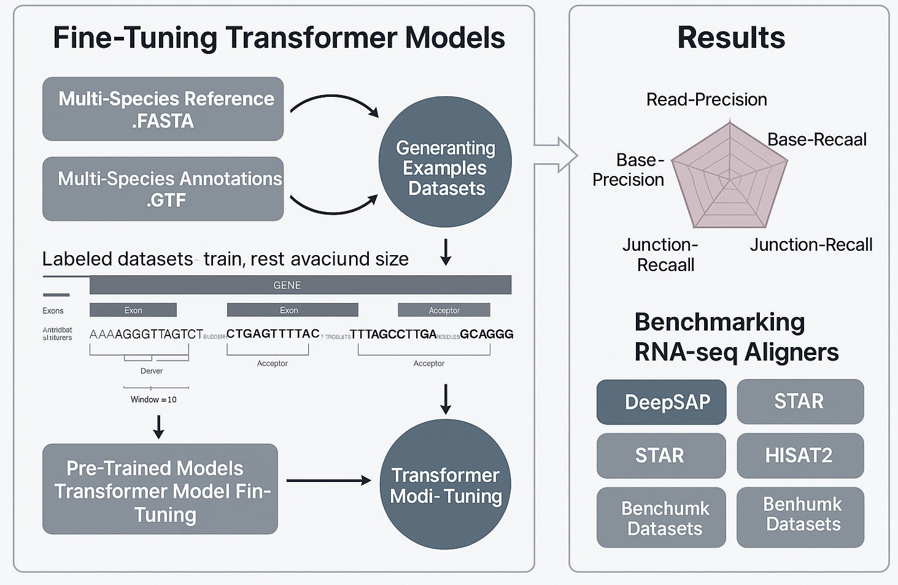
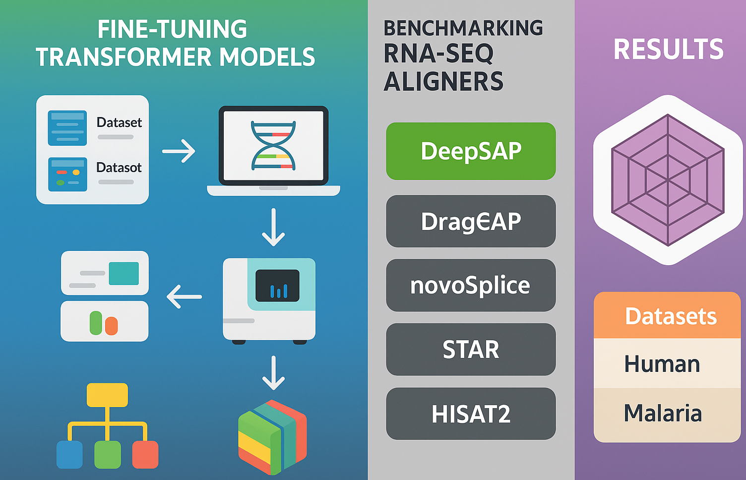
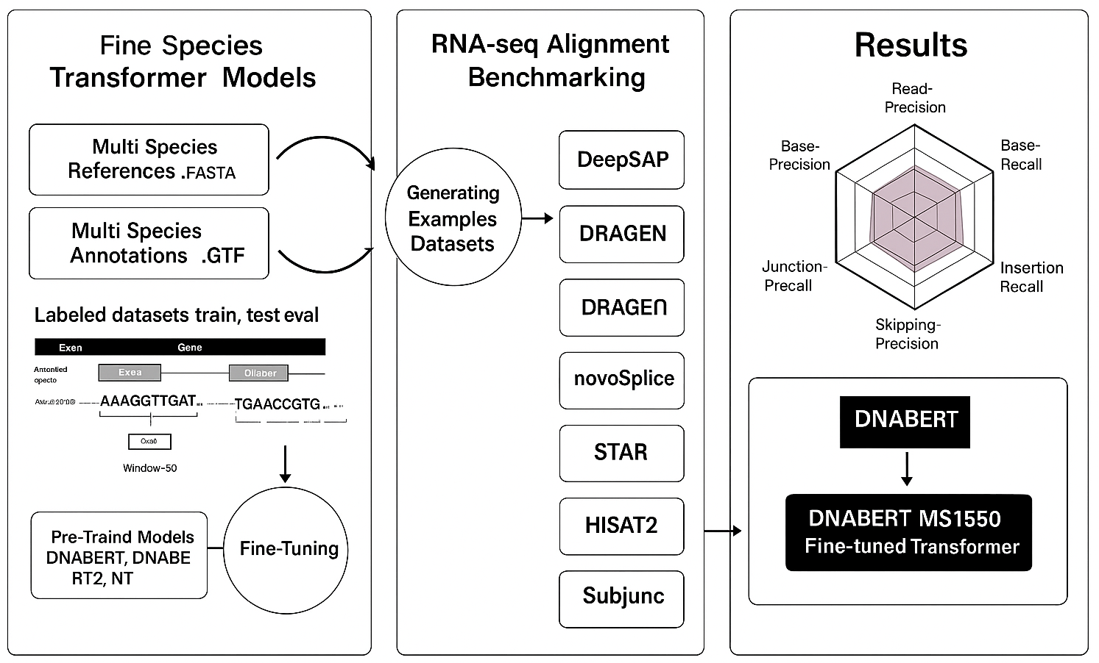
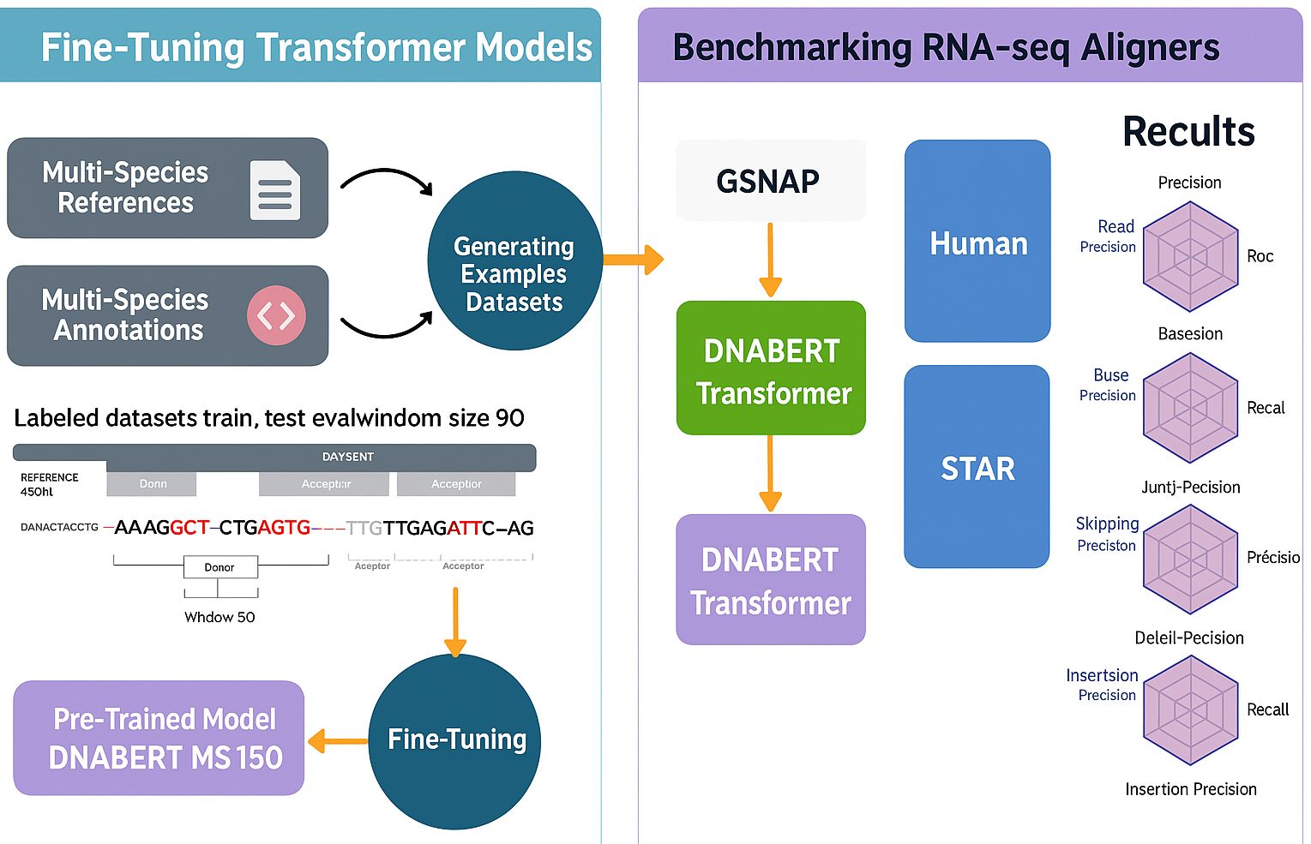
Ideas for the graphical Abstract

Slide 3








DeepSAP Stage 1: align reads using GSNAP TGGA Stage 2: apply transformer scores
Multi Species References
Genome and Annotation
Nextflow
Pipeline
Benchmarking Study
Generating Example
Datasets
DNABERT
MS150
Best Performing Model Across Multiple Species
DeepSAP
SimBA Datasets
DRAGEN
Shinyapp
Dashboard
Models
Evaluation
novoSplice
Baruzzo Datasets
STAR
HISAT2
Baruzzo Reference Genome and Annotation
Pre-Trained
Transformers
Fine
Tuning
Fine-Tuned
Transformer Models
Subjunc

